Slide 1
CMO area of responsibility
Employers’ View
Komissarova T. A.,
Higher School of Marketing and Business Development dean, МВА
Moscow, 2019

Slide 2
Higher School of Marketing and Business Development
The objective
The aim of our research was to make a comprehensive portrait of marketing director and to find what competences and functions of CMO are highly demanded among Russian employers in the beginning of 2019.
First of all, we outlined the area of CMO’ responsibility according to job announcements;
Then, we counted highly demanded competences of CMO on the Russian market;
Finally, we defined the difference between the role of CMO in companies focused on B2C and B2B markets.

Slide 3
Higher School of Marketing and Business Development
Methodology
We analyzed 162 job announcements posted at Head Hunter* for the period from 01.18.2019 till 02.18.2019
We looked through all these posts and found set of typical functions that are considered to handle by CMO, and competences which marketing director is likely to have.
Research limitation
Research geography: Russian Federation
3 years minimum work experience as marketing or commercial director.
* The most popular web-portal job seekers in Russia

Slide 4
Higher School of Marketing and Business Development
The Sample
The sample consist of 162 job descriptions, 112 or 70% of which was posted in Moscow, Saint-Petersburg, Novosibirsk region, Sverdlovsk region, Voronej region and Krasnodar krai.
In 38% posts wage rate was not announced. In 23% posts declared wage rate lies between 90 000 RUB and 140 000 RUB and only 4% of job descriptions offer wage above 295 000 RUB.
Regions with highest demand for CMO
Wage Rate

Slide 5
Higher School of Marketing and Business Development
Functions and Competences
Below you can find the list of the most frequent competences and functions mentioned in CMO’ job descriptions. We also played attention to functions which were mentioned rarely but presents upcoming trends such as big data analysis, Agile SCRUM and some other flexible techniques of project management.
As you can see, there is a gap between tasks CMO should work on and competence he pretended to have.
Functions
Management | BTL/Trade marketing & sales promotion
Strategy | Pricing
Budget and planning | Product development
Brand development | Sales
Marketing research | CRM
PR & Advertising | Efficiency
Digital marketing | Content marketing
Competences
WEB-analysis | Data bases
Performance marketing | Strategic planning
Product launch | Communication
KPI | Organizational skills
Sales | Creativity
Notes:
cайт, соцсети, SMS, e-mail, мессенджеры

Slide 6
Higher School of Marketing and Business Development
B2c: Functional Portrait

Slide 7
Higher School of Marketing and Business Development
B2B: Functional Portrait

Slide 8
Higher School of Marketing and Business Development
B2c: Competence Portrait

Slide 9
Higher School of Marketing and Business Development
B2B: Competence Portrait

Slide 10
Higher School of Marketing and Business Development
Conclusion
B2C market. The key function of CMO is strategy development (95). According to job descriptions, marketing director should be able to make business strategy and operation plan as well as advertising and digital strategy. In the meantime, employers consider performance marketing as a “gold” competence of CMO.
B2B market. Performance marketing is also highly demanded competence of marketing director (100) alongside with organizational skills (100). Basically, employers expect that their CMO know how to make profitable PR and advertising (94), to tune customer relationships (88), and to work on content marketing (88).
The gap between competences and professional tasks. In fact employers seek for a person who first of all can make performance marketing (100) and has organizational skills (95). However, the main task for CMO is dealing with corporate marketing strategy.
This study shows CMO’s area of responsibility now is changing form the classical mode and as a result demand for competences is also changing.

Slide 11
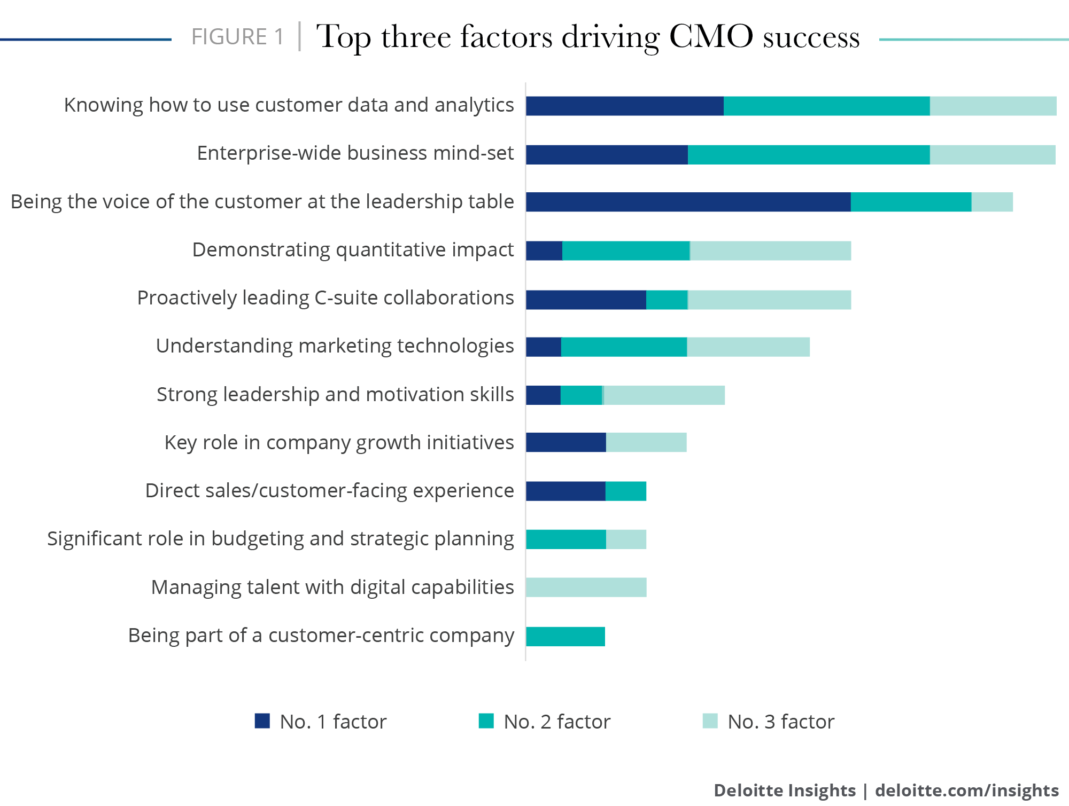
Higher School of Marketing and Business Development
Redefining the CMO
40 structural interviews with CMO made by Deloitte in 2018 also shows the gap between functional and competences.
This gap was called CMO paradox.
“CMOs are expected to play an enterprise-minded role in organizations, but often don’t have the authority and responsibility to be effective.
Fully half of our interviewees said having an enterprise-wide mind-set was one of the most important factors in a CMO’s success.
Yet a far smaller proportion thought it was important for CMOs to have a voice in company growth initiatives, own a significant role in budgeting and strategic planning, or be part of a customer-centric company—all factors that typically come with having an enterprise-wide mind-set (see figure).”
Source: https://www2.deloitte.com/insights/us/en/deloitte-review/issue-22/redefining-the-role-of-the-cmo-chief-marketing-officer.html

Slide 12
Higher School of Marketing and Business Development
12 powers of marketing leader
Thomas Barta, former McKinsey partner, and Patrick Barwise, Emeritus Professor of Management and Marketing at London Business School, asked more than 1200 CMOs from 74 countries to find the boundaries of their area of responsibility.
According to the research, 77% of CMOs said communications. Then, came brand development (whatever that means) on 63%; product development on 56%; and sales promotion and customer retention, both on 55%
Source: https://www.marketingweek.com/2019/01/11/thomas-barta-point-cmo/

Slide 13
Higher School of Marketing and Business Development
RUSSIA IN GLOBAL CONTEXT
CMO functional according Graduate School of Marketing and Business Development
(Employers expectations)
12 powers of marketing leader
(Actual functional)
Highest:
Strategy, communications, CRM
Highest:
Communications and brand development

Slide 14
Higher School of Marketing and Business Development
RUSSIA IN GLOBAL CONTEXT
According to three above mentioned researches, communications play significant role in CMO’ job. He has to develop both internal communications with inferiors and colleagues, and external communication, such as customer relations and product promotion.
Russian employers believe that strategy is a vital task for CMO, however two other studies do not show that strategy development has higher priority. Thomas Barta says that only 39% of CMO included strategy in their functional. Instead of strategy CMOs are involved in product (63%) and brand (50%) development.
Deloitte’ conclusion is pretty much close to the one of Barta but they emphasize that strategic partnership with clients become more and more significant for marketing.

Slide 15
www.marketing.hse.ru
Теl.: +7 (495) 959-45-52
Address: Krivokolenny per, 3, office 3-323, 3-324, 3-325

